Slide 1
Practical intro to SHIny
And other lessons from RSTUDIO::conf 2019
Clara Oromendia – Computing Club 1/31/2019

Slide 2
Lessons from Rstudio::Conf
All lectures : https://resources.rstudio.com/rstudio-conf-2019
Workshop materials: https://github.com/rstudio/rstudio-conf/tree/master/2019

Slide 3
General
People like stickers.
Intentional inclusivity makes a difference
Twitter is huge
It’s exhausting to meet people

Slide 4
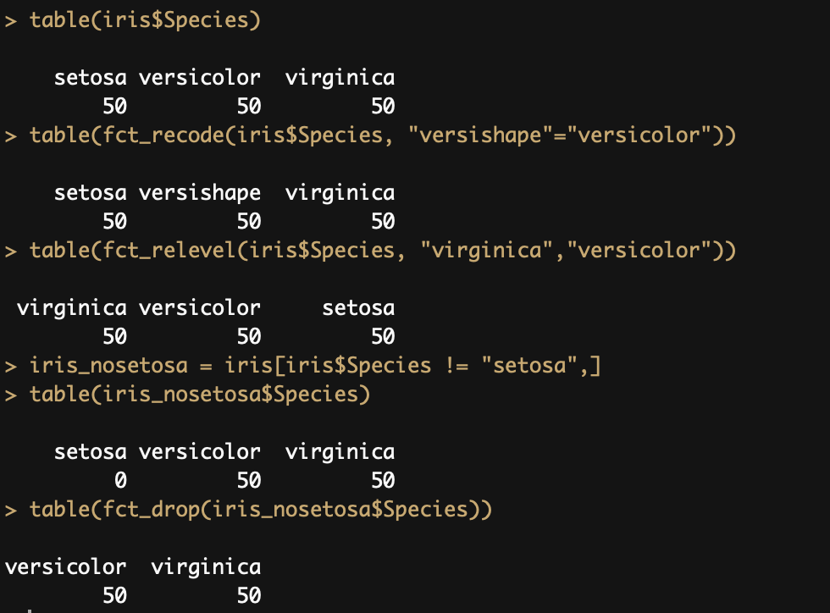
FOrcats

Slide 5
Broom

Slide 6
Broom

Slide 7
Rstudio Tips
Use projects
Faster typing
Snippets: lib + tab → library(…)
Shortcuts
Debug using browser()

Slide 8
Intro to SHINY
Some Slides taken with permission from AIMEE GOTT and RSTUDIO TEAM

Slide 9
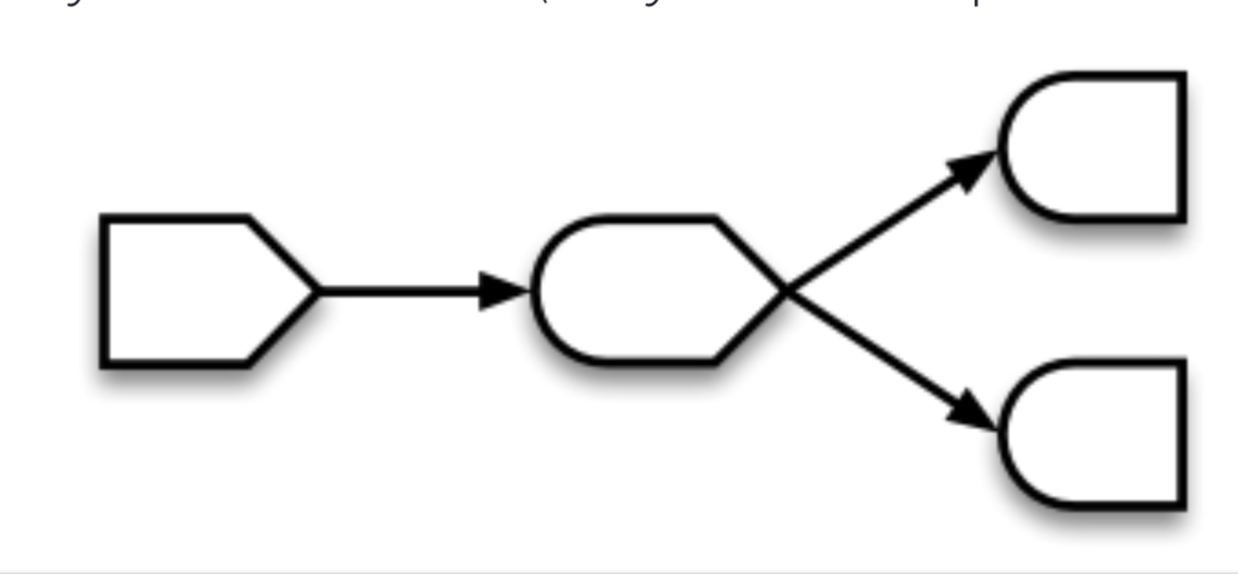
SHINY basics
Reactive programming with R
X = 4
Y = 3 + X
X = 7
Y = ?
Runs as HTML
plot(Y)
X = 4
Y = 3 +X
print(Y)

Slide 10
Example 0: Built in
Rstudio has a (boring) shiny template
New File - > Shiny Web App
App separated into UI and Server
print(Y)

Slide 11
Example 0b: Movies
Navigate to folder app0b_movies and open app.r
Green play button will appear – press to launch!
App separated into UI and Server

Slide 22
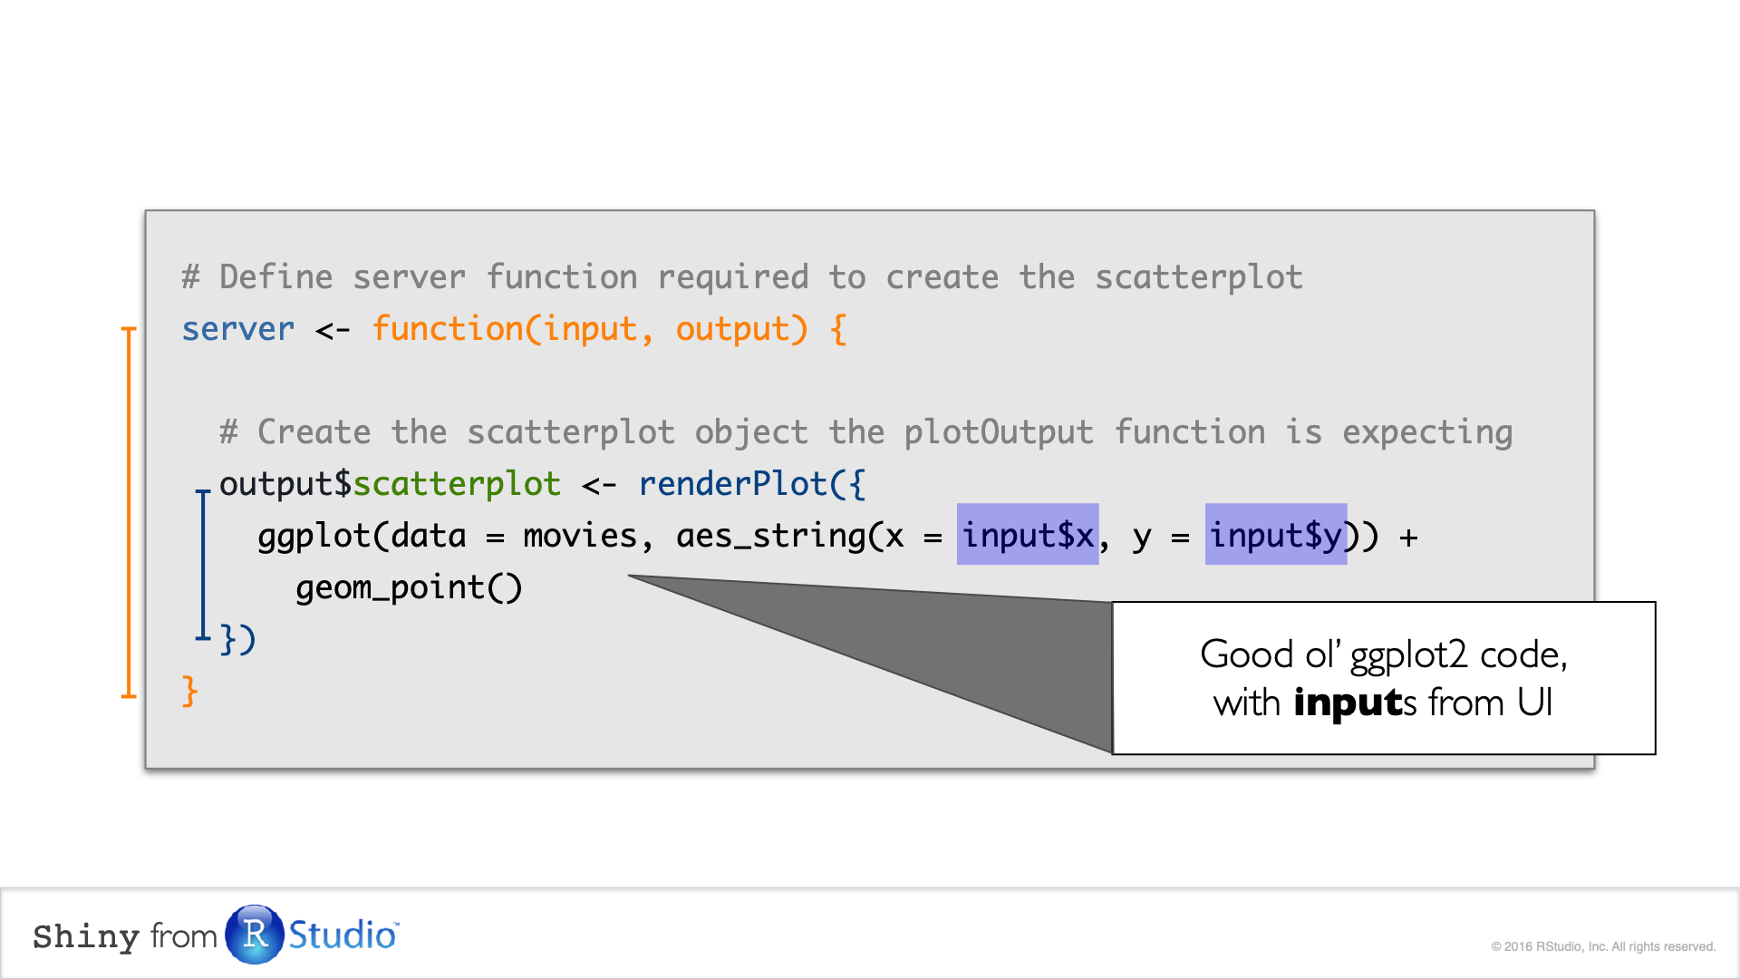

Slide 25
App 1: Plot My data
Example of what it can be used for
Plot changes depending on the type of variable
Quick way to look at the data, QC, plan analysis
Not p-hacking

Slide 26
App 2: Plot Your data
Upload CSV
Could be the one in the folder, or any on your computer
Explore!

Slide 27
App 3: Plot and see Your data
Grow the app bit by bit
UI changed to tabs
Try it out:
Use renderTable() and tableOutput() to display the dataset
Solution found in: app3_plotAndSeeYourData_soltn

Slide 28
App 3: Plot and see Your data
# UI
tabPanel("Full Data - Normal",
tableOutput("data_raw")),
# Server
output$data_raw <- renderTable(dat())

Slide 29
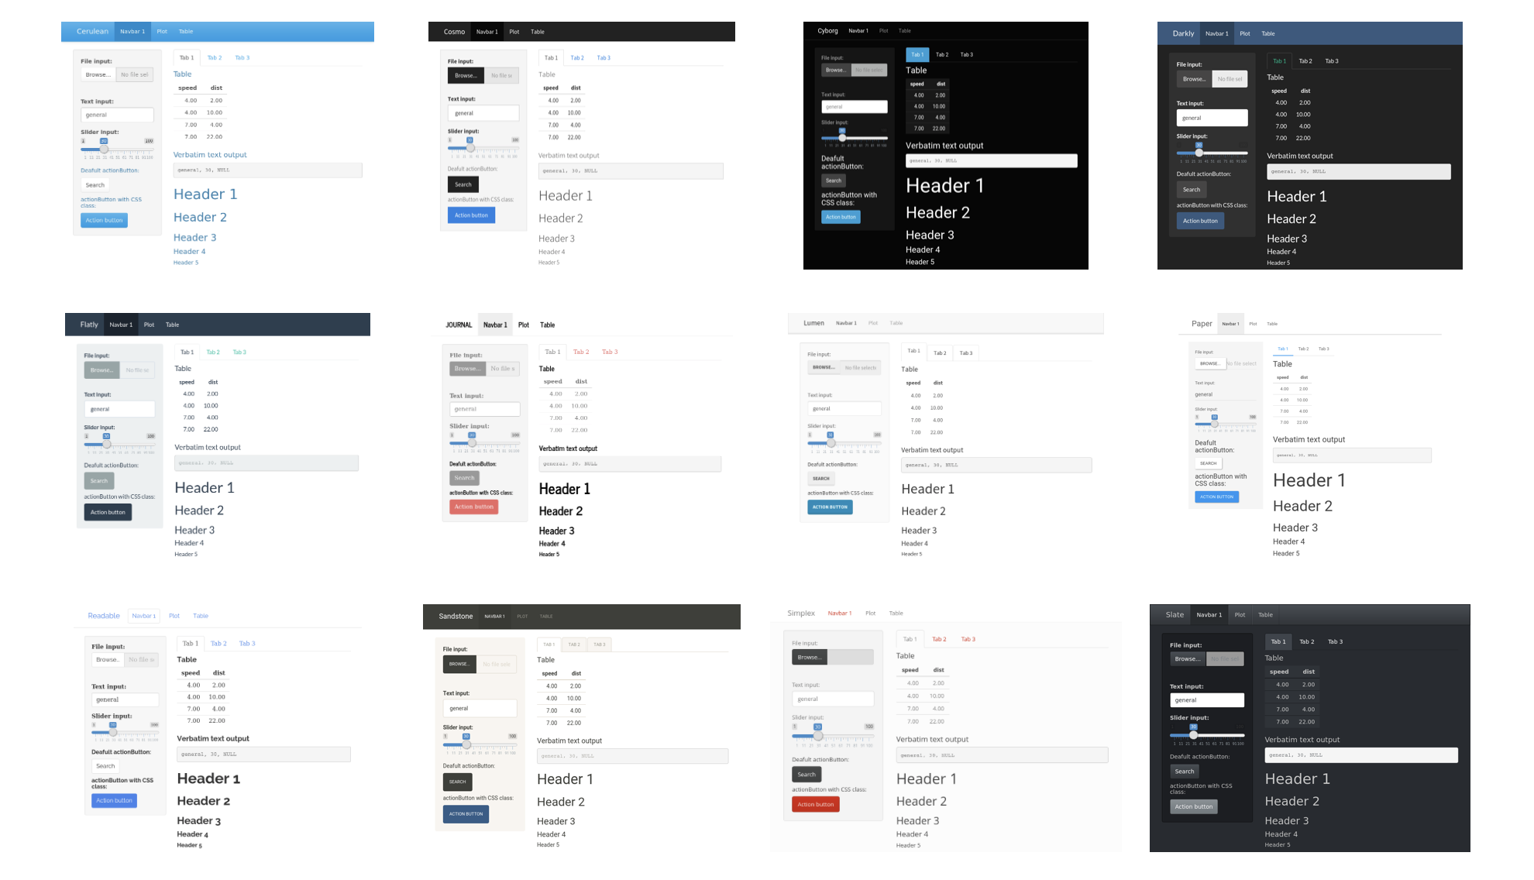
App 4: Play with themes in CEDAR

Slide 30
Debugging
Debugging Shiny is a pain
Many parentheses, ids, and parts
Sometimes things don’t show up
Check that ids match
Tools:
Use renderText() with print()
Go inside the app using the red button in Rstudio or browse
Version control…

Slide 31
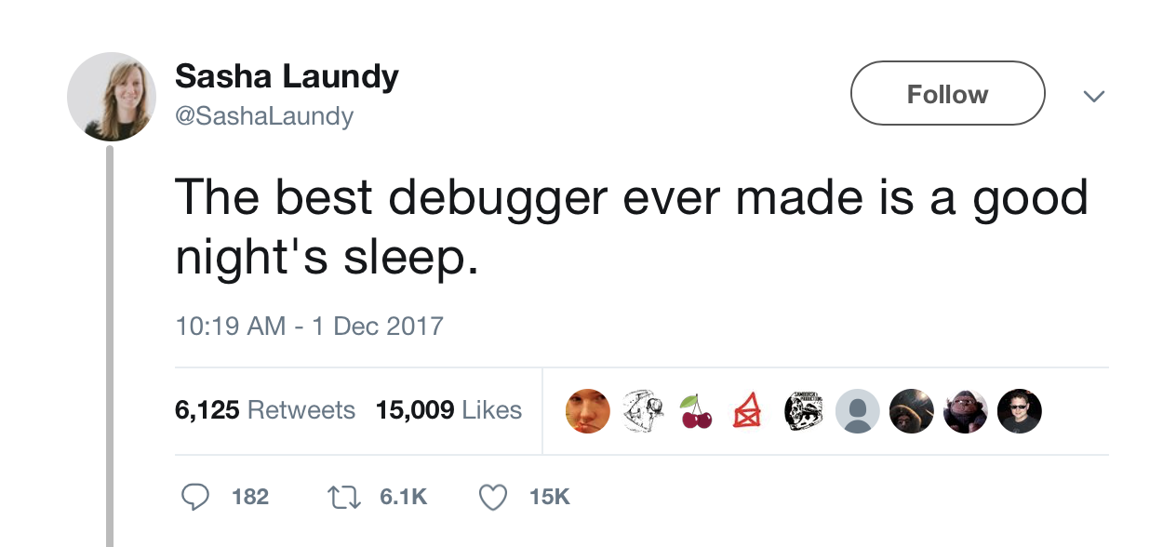
Debugging
Notes:
This actually happened last week!

Slide 32
Debugging
Notes:
This actually happened last week!

Slide 33
Shiny recap
Reactive programming using R -> start from the output
Start small, build by parts
It really is doable!

Slide 34
Take your app to the next level
Separate UI and server into files (add global.r file)
Use modules as functions
Use the same code to plot different datasets
Same app, different dataset (CEDAR and PINE)
Only plot when a button is pressed
Cache plots that take a bit to compute
Take snapshots of current state
Download files
Publish app through Rstudio or in private server
Flexdashboards for more advanced formatting

Slide 35
Thanks!
Full slides available online

